Slide 1
SPAs with React Router
Overview of React SPAs
Simple routing
Router techniques
Defining links
Link techniques

Slide 2
1. Overview of React SPAs
React and SPAs
Dependencies for React Router

Slide 3
React and SPAs
React has excellent support for implementing SPAs
Define an App component that always remains resident
Define multiple sub-components, which can be swapped in and out of the App component
Each sub-component maps to a logical URL
This is called "routing"
To display a different sub-component in the browser, simply navigate to the URL for that sub-component
3

Slide 4
Dependencies for React Router
To implement routing in React, add the following dependencies in your package.json file
You can make these changes as follows:
{
"dependencies": {
"react-router-dom": "^5.2.0",
"@types/react-router-dom": "^5.1.8",
…
},
…
}
React Router
React Router TypeScript declarations
package.json
npm install --save react-router-dom [for TypeScript or JavaScript]
npm install --save @types/react-router-dom [for TypeScript only]
4

Slide 5
2. Simple Routing
Example application
Creating a router component
Defining a route table
BrowserRouter vs. HashRouter

Slide 6
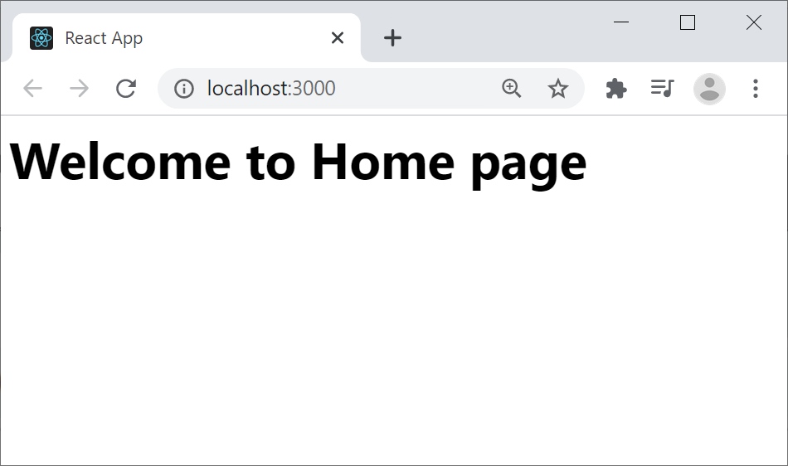
Example Application
We've implemented a simple example application to illustrate the key features in React routing
Go to the demo-app-1 folder and run
Navigate to the following URLs:
http://localhost:3000/
http://localhost:3000/products
http://localhost:3000/about
http://localhost:3000/contact
npm start
6

Slide 7
Creating a Router Component (1 of 2)
To enable routing in a React application, you must create a "router" component
Detects URL changes
Activates the appropriate component, for current URL
In a web app, react-router-dom provides two different types of router:
<BrowserRouter> and <HashRouter>
We'll discuss the differences shortly
7

Slide 8
Creating a Router Component (2 of 2)
To use a router, render a "router" component at the root of your element hierarchy
Typically, you wrap your <App> root element in a router:
import { BrowserRouter } from "react-router-dom";
…
ReactDOM.render(
<BrowserRouter>
<App />
</BrowserRouter>,
document.getElementById('root')
);
index.tsx
8

Slide 9
Defining a Route Table
Define a route table via <Switch> and <Route>
import { Switch, Route } from 'react-router-dom';
…
function App() {
return (
<div>
<Switch>
<Route path="/products">
<Products />
</Route>
…
<Route path="/" >
<Home />
</Route>
</Switch>
</div>
);
}
export default App;
Notes:
Each route maps a relative path to a component
Routes are searched from top to bottom
Paths are partially matched from start
So you must arrange your routes from specific to general
App.tsx
9

Slide 10
<BrowserRouter> vs. <HashRouter>
<BrowserRouter> is preferred in production
Uses regular URLs, e.g. example.com/products
Supports HTML5 browser history
Requires server config (serve home page for all requests)
<HashRouter> can be useful during development
Uses # in URLs, e.g. example.com/#/products
Doesn't require server config
10

Slide 11
3. Router Techniques
Example application
Providing a splash screen
Recap path matching in prev demo
Exact path matching
Redirecting paths
Handling 404 errors

Slide 12
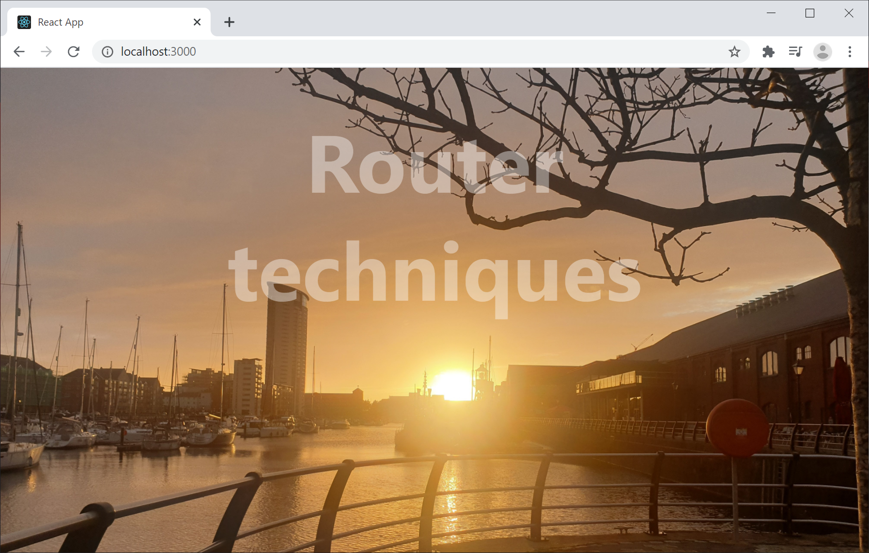
Example Application
Go to the demo-app-2 folder and run
Navigate to the following URLs:
http://localhost:3000/
http://localhost:3000/products
http://localhost:3000/catalog
http://localhost:3000/about
http://localhost:3000/contact
http://localhost:3000/wibble
npm start
12

Slide 13
Providing a Splash Screen
Our Home component provides a splash screen
Note how we import the image file
Enables us to refer to the image file in our code
import React from "react";
import './Home.css'
import splash from './swanseamarina.jpg';
function Home() {
return (
<div className="container">
<img src={splash}/>
<div className="centered">Router techniques</div>
</div>
)
}
export default Home;
Home.tsx
13

Slide 14
Recap Path Matching in Previous Demo
In the previous demo we defined our route table like so
As we pointed out, React Router matches paths by saying "does the path start with this"
So you have to put specific paths before general paths
<Switch>
<Route path="/products">
<Products />
</Route>
…
<Route path="/">
<Home />
</Route>
</Switch>
App.tsx in previous demo
14

Slide 15
Exact Path Matching
A better approach is to specify exact paths as follows:
This means you can define your route table entries in any order you like ☺
<Switch>
<Route exact path="/">
<Home />
</Route>
…
<Route path="/contact">
<Contact />
</Route>
</Switch>
App.tsx in current demo
15

Slide 16
Redirecting Paths
You can redirect paths to different paths - like an alias
<Switch>
<Route path="/catalog">
<Redirect to="/products" />
</Route>
<Route path="/products">
<Products />
</Route>
…
</Switch>
App.tsx
16

Slide 17
Handling 404 Errors (1 of 2)
You can handle 404 errors as follows:
See the PageNotFound component on next slide
<Switch>
…
<Route path="*">
<PageNotFound />
</Route>
</Switch>
App.tsx
17

Slide 18
Handling 404 Errors (2 of 2)
Here's the PageNotFound component
We use the global variable window.location to get the URL requested by the user
import React from "react";
import './PageNotFound.css'
function PageNotFound() {
return (
<div className="pagenotfound">
<h1>OOPS 404</h1>
<p>Invalid URL: {window.location.pathname}</p>
<p>Full URL: {window.location.href}</p>
</div>
)
}
export default PageNotFound;
PageNotFound.tsx
18

Slide 19
4. Defining Links
Example application
How to display a link
How to style links
Link vs. NavLink

Slide 20
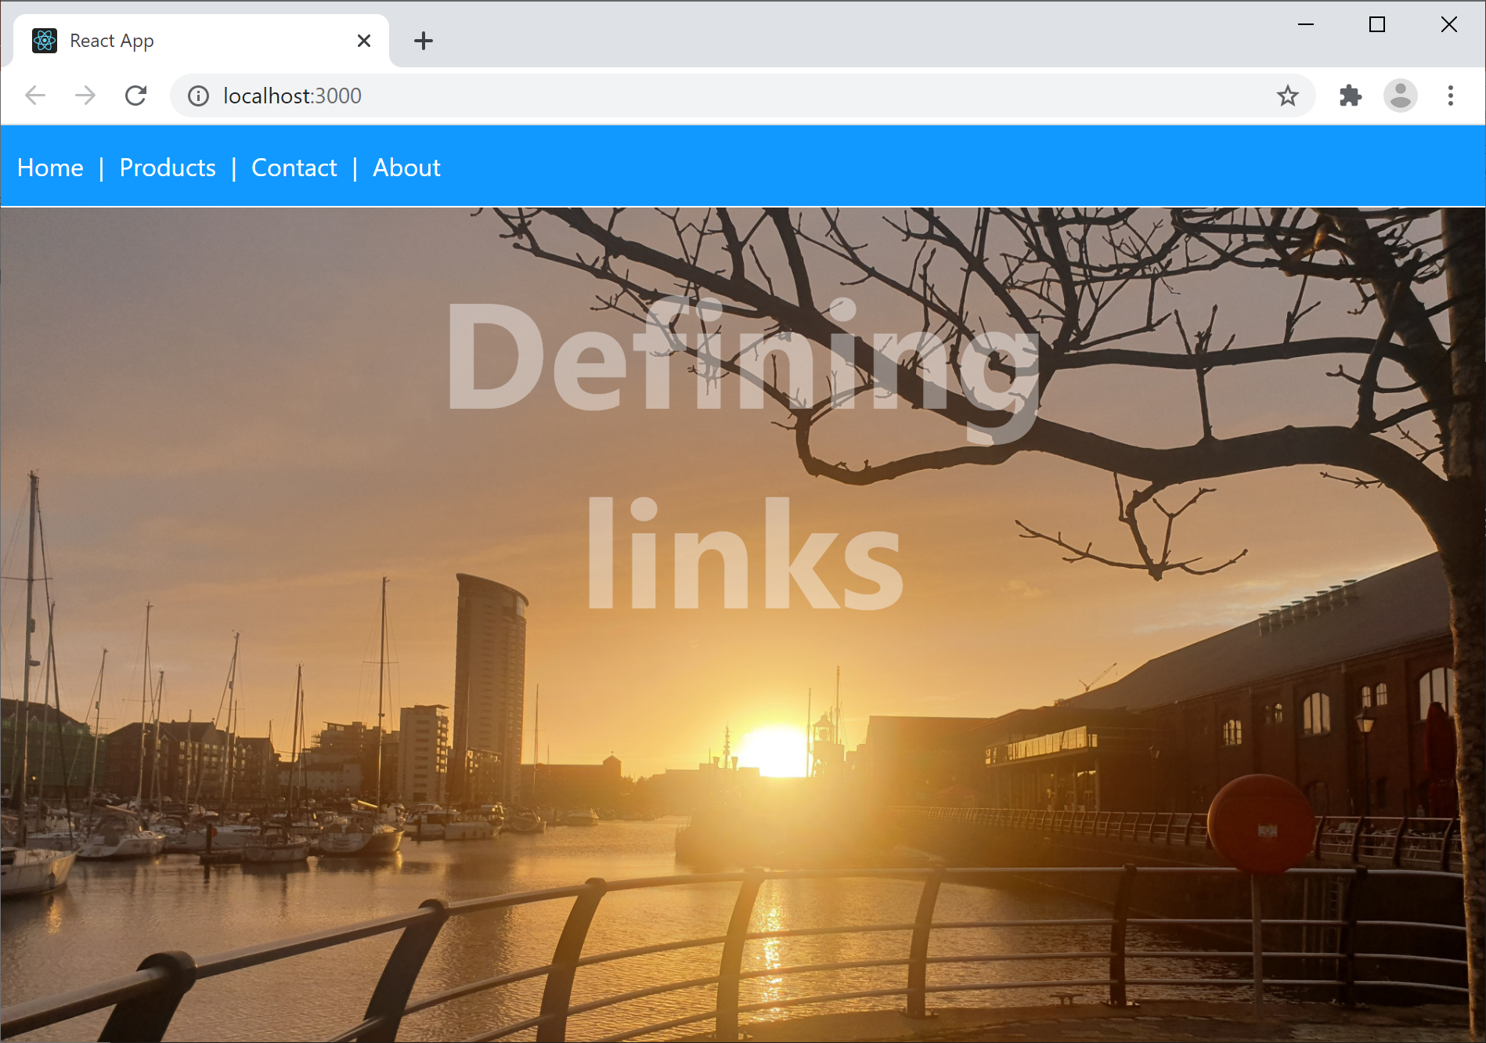
Example Application
Go to the demo-app-3 folder and run
Note we've defined a menu bar of links
Try out each link ☺
npm start
20

Slide 21
How to Display a Link
To define a link, use <Link> as shown below
(Also see App.tsx, where we render the menu)
import React from "react";
import { Link } from "react-router-dom";
import "./Menu.css";
function Menu() {
return (
<nav>
<Link to="/">Home</Link>&nbsp;|&nbsp;
<Link to="/products">Products</Link>&nbsp;|&nbsp;
<Link to="/contact">Contact</Link>&nbsp;|&nbsp;
<Link to="/about">About</Link>
</nav>
)
}
export default Menu;
MenuWithLinks.tsx
21

Slide 22
How to Style Links
When you define a <Link to="xxx"> element…
React renders it as an <a href="xxx">
So you can define CSS styles like this:
nav a {
background-color: #1199ff;
color: white;
text-decoration: none;
padding: 5px;
}
nav a:hover {
color: #1199ff;
background-color: white;
text-decoration: none;
}
Menu.css
22

Slide 23
Link vs. NavLink
As well as <Link>, React also provides <NavLink>
<NavLink> is similar to <Link>, except…
<NavLink> applies active CSS style to current link
For an example of how to use <NavLink>:
See MenuWithNavLinks.tsx
For an example of how to style the active link:
See Menu.css
23

Slide 24
5. Link Techniques
Overview
Example application
Defining a data model
Defining parameterized routes
Rendering parameterized links
Obtaining path parameters
Defining nested routes

Slide 25
Overview
In this section we'll see various additional techniques pertaining to links
We'll introduce a "products" data model, and use it to describe the following techniques:
Defining parameterized routes
Rendering parameterized links
Obtaining path parameters from a parameterized route
Defining nested routes
25

Slide 26
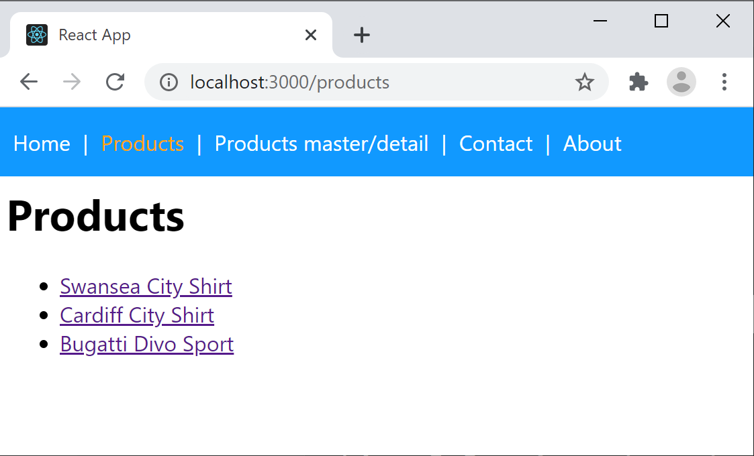
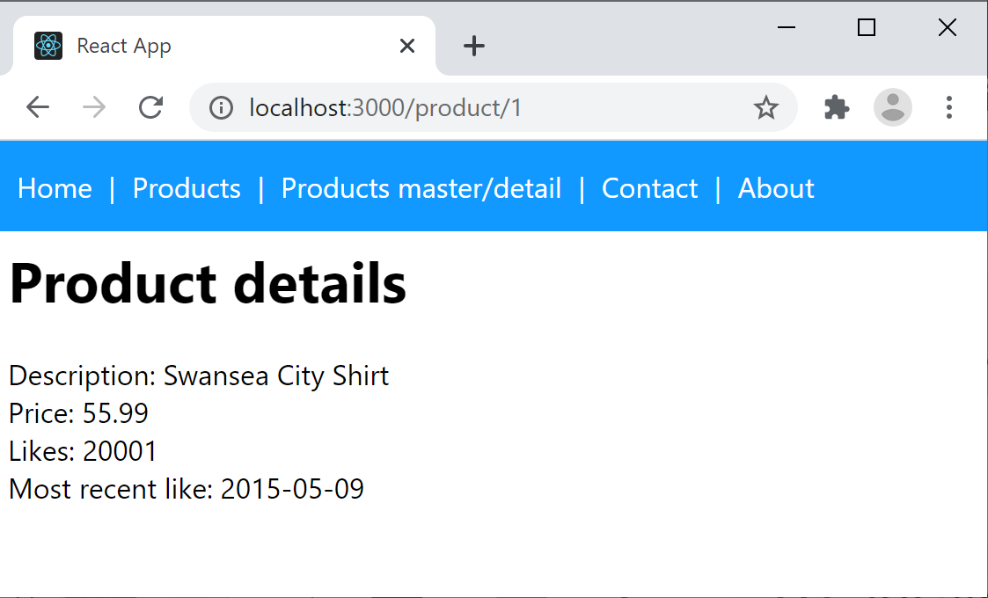
Example Application
Go to the demo-app-4 folder and run
Click the Products link, to display all products
Click a link to see the details for one product
npm start
26

Slide 27
Defining a Data Model
To understand the example application, the first stop is to consider the data model
Take a look at the following TypeScript class files:
ProductItem.ts - Represents a simple product
ProductStore.ts - A simple product store
27

Slide 28
Defining Parameterized Routes
Here's part of the route table
/products - Display all products
/products/:id - Display product with specified id
<Switch>
<Route path="/products">
<Products />
</Route>
<Route path="/product/:id">
<Product />
</Route>
…
</div>
App.tsx
28

Slide 29
Rendering Parameterized Links
Products.tsx renders parameterized links like so:
function Products() {
let products = ProductCatalog.getAllProductItems()
return (
<React.Fragment>
<div className="content">
<h1>Products</h1>
<ul>
{products.map((product, i) =>
<li key={i}>
<Link to={`product/${product.id}`}>{product.description}</Link>
</li>
)}
</ul>
</div>
</React.Fragment>
)
}
export default Products;
Products.tsx
29

Slide 30
Obtaining Path Parameters
Product.tsx obtains path parameters like so:
function Product() {
let {id}: any = useParams();
let prod: ProductItem | undefined = ProductCatalog.getProductItemById(id)
if (!prod) {
…
}
else {
return (
<div className="content">
<h1>Product details</h1>
<div>Description: {productItem.description}</div>
…
</div>
)
}
}
export default Product;
Product.tsx
30

Slide 31
Defining Nested Routes
You can define nested routes
i.e. a page can define its own internal route table
This enables you to create master/detail pages…
Click the Products master detail link on the menu
Renders a "master" page of all products
Click a product, renders the selected product below
See ProductsMasterDetail.tsx
31

Slide 32
Summary
Overview of React SPAs
Simple routing
Router techniques
Defining links
Link techniques

